Slide 1
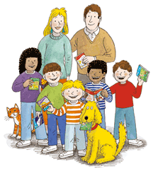
Meet the Oxford Reading Tree Characters

Slide 2
This is the Robinson Family

Slide 3
This is Kipper, his real name is Christopher but when he was younger he couldn’t say Christopher so he called himself Kipper instead!

Slide 4
This is Biff. Her real name is Barbara. She is Chip’s twin and Kipper’s sister.

Slide 5
This is Chip. His real name is David. He is Biff’s twin and Kipper’s big brother.

Slide 6
Here are Kipper, Biff and Chip’s Parents – they are called Mum and Dad.

Slide 7
This is Floppy, he is the Robinson family dog.

Slide 8
This is Gran, she takes the children on lots of adventures.

Slide 9
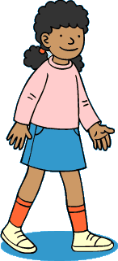
This is Wilf and Wilma. They are Biff and Chip’s friends. Wilf and Wilma are brother and sister.

Slide 10
To find out more about the characters click here

